Slide 1
Empowering Retail with Data-Driven Insights
XYZ Retail Inc. is revolutionizing its operations by building a scalable data pipeline to optimize multi-channel sales and unlock powerful analytics. This presentation will showcase the comprehensive solution leveraging Azure, Databricks, Synapse, and Power BI. By: Shreyans jain || GITHUB: My githb repo link

Slide 2
Problem Statement: XYZ Retail Inc., a prominent player in the retail industry, faces the challenge of efficiently managing and analysing its sales data. The company operates through multiple channels like online platforms, physical stores, and mobile apps. To enhance decision-making, XYZ Retail aims to create an end-to-end data pipeline that ingests, processes, and visualizes sales data.
Objective: Optimize retail operations by designing scalable data pipelines, integrating and cleaning diverse data sources, and enabling advanced analytics through robust storage, transformation, and governance frameworks.

Slide 3

Sales Data Analysis Workflow
. Data Ingestion and Storage
Created two folders in Azure Storage within the Sales Containers:
Raw Data: For storing unprocessed datasets.
Transformed Data: For storing cleaned and processed datasets.
Ingested raw sales data using the GitHub raw file link, ensuring a streamlined and scalable data input pipeline.

Slide 4
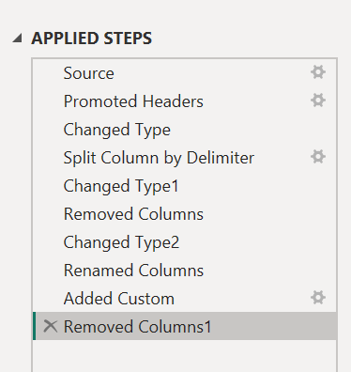
2. Data Transformation Steps Databricks Transformation: Loaded raw data into Databricks for initial cleaning and processing: Handled missing values, duplicates, and outliers. Standardized date formats and ensured consistent column naming conventions. SQL Transformation in Synapse: Imported transformed data from Databricks into Azure Synapse. Performed further transformations using SQL queries: Derived key metrics like Total Sales and Average Order Value (AOV). Conducted channel-wise performance analysis for online, in-store, and mobile app sales 3. Power BI Visualization Exported the final transformed dataset from Azure Synapse to Power BI. Conducted additional data transformations in Power BI to prepare the data for visualization. Designed an interactive dashboard with the following features: Slicers for filtering by sales channels, regions, and product categories. Key Performance Indicators (KPIs) displayed prominently: Total Sales Average Order Value (AOV) Customer Retention Rate Trend Analysis: Monthly, weekly, and daily sales patterns were highlighted, identifying peak sales periods and seasonal trends.

Slide 5

4. Actionable Insights
Operational Optimization: Suggested reallocating resources to high-performing channels.
Inventory Management: Recommended stocking up on best-sellers during peak periods.
Customer Retention: Advocated targeted offers and loyalty programs for high-value customers.
Conclusion
The solution leverages Azure services, Databricks, Synapse, and Power BI to create a robust, end-to-end data processing and visualization pipeline. This setup enables real-time, data-driven decision-making by providing insights into customer behavior, product performance, and operational efficiency.

Slide 6
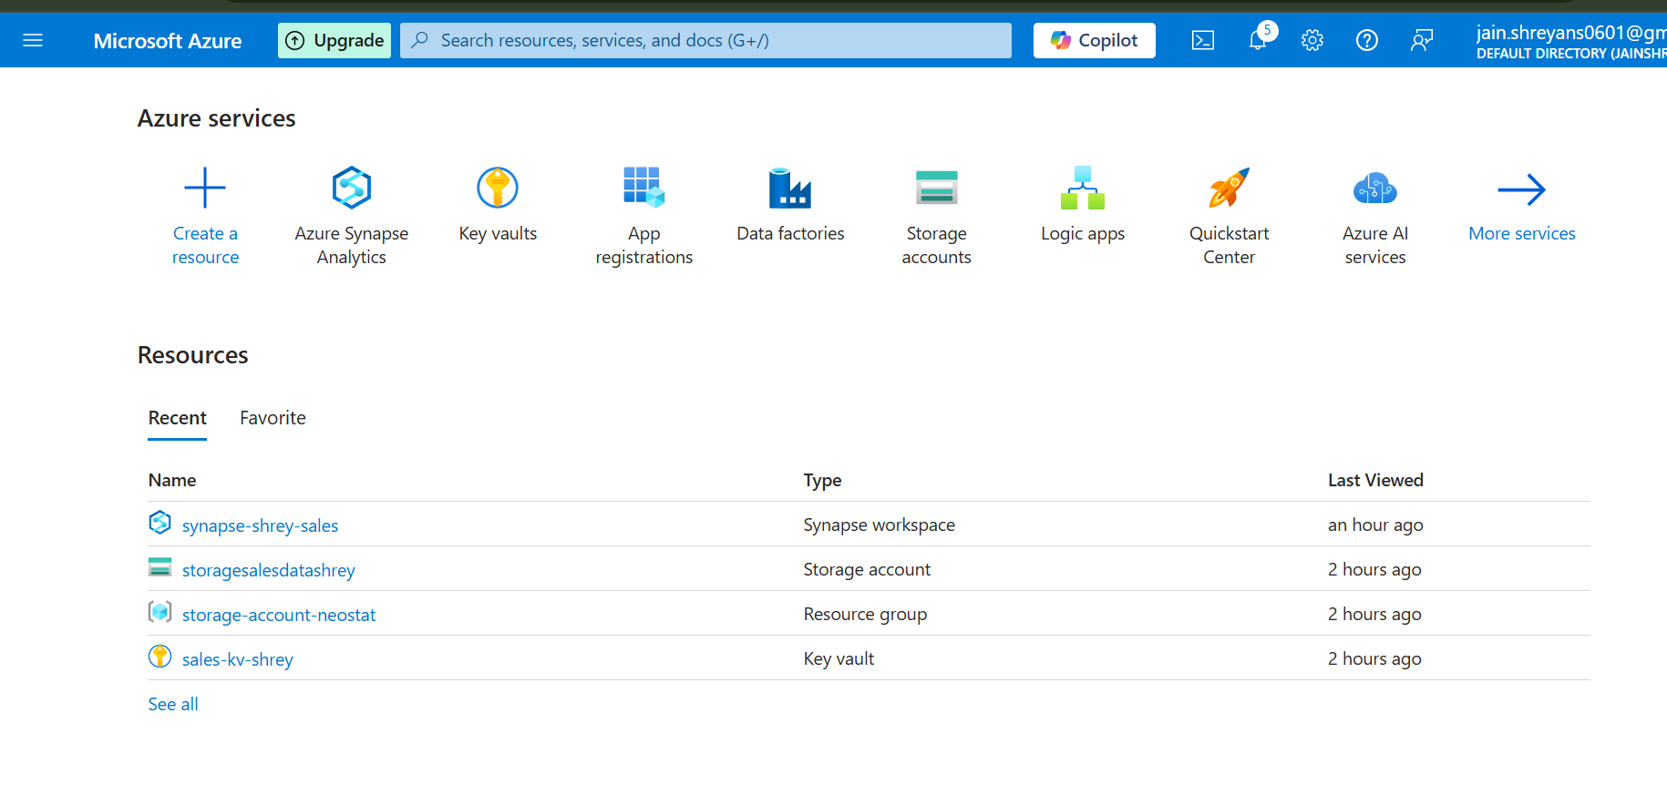
Dashboard

Slide 7
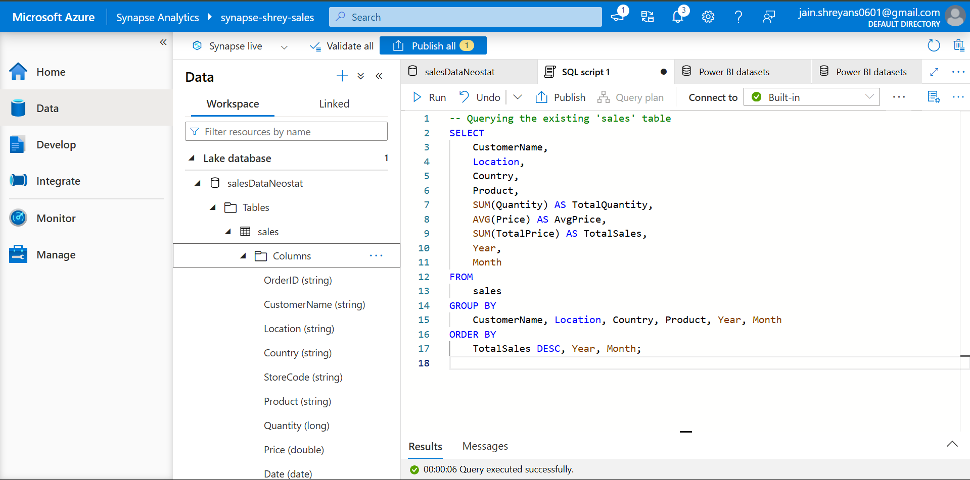
Synapse

Slide 8
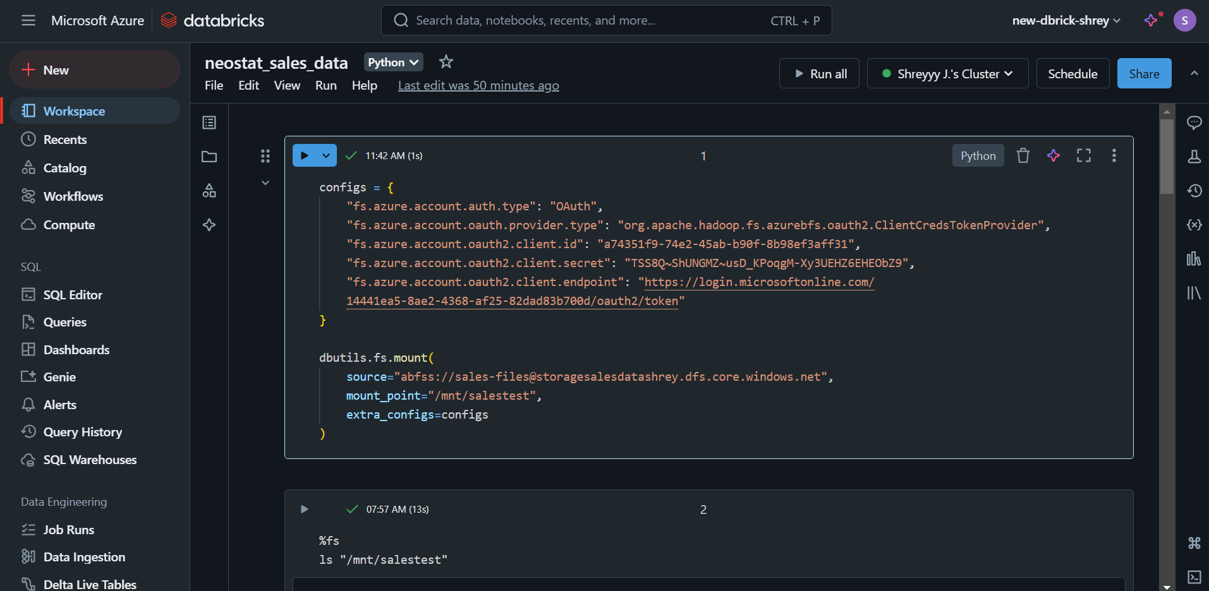
DATABRICKS

Slide 9
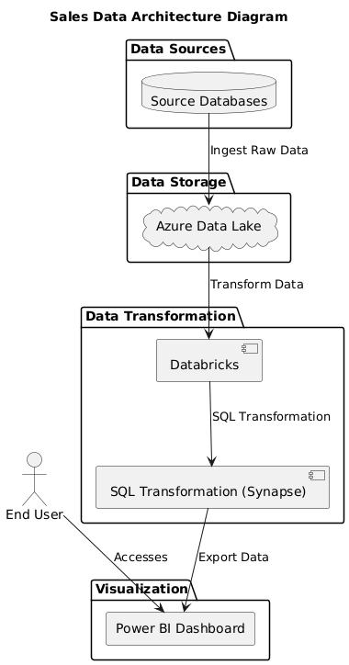
Architecture Diagram

Slide 10
Roadmap
SOURCE : DATABASE
TRANSFORM:
DATABRICKS & SYNAPSE
STORAGE:
DATA LAKE
VISUALIZATION:
POWERBI
ANALYSES:
INSIGHTS

Slide 11
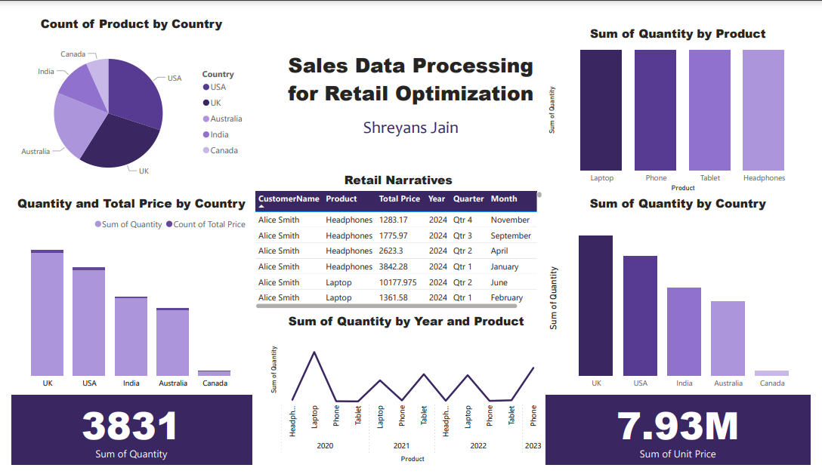
PowerBI Dashboard

Slide 12
Conclusion The dashboard integrates data transformation and visualization effectively to derive actionable insights. Key takeaways include: Top Performing Regions and Products: The UK and USA dominate sales, while laptops and phones perform best. Customer and Seasonal Insights: Detailed breakdowns in retail narratives and sales trends aid targeted strategies. This dashboard is a valuable tool for driving data-driven decisions in sales optimization and resource allocation

Slide 13
Contact Me
LinkedIn Link to Your LinkedIn Profile
Email shreyans.jain@mca.christuniversity.in
Phone +919958510891

